Slide 1
Preparing Students for a Subsequent Diagnostic
The most important thing you can do to get accurate data is to motivate students to put forth their best effort on the i-Ready Diagnostic. Before administering a subsequent Diagnostic, use the following resources to energize students, review expectations, and set goals. In this document, you will find four PowerPoint® presentations to prepare your students for a subsequent Diagnostic. See below to locate your grade-level presentation.
Presentations Included:
Tips:
Internalize the presentation by reviewing it ahead of time.
Show this presentation the day of or a day before the Diagnostic.
Schedule time for the presentation.
Check in with students for understanding along the way.
End the presentation by asking students what strategies they want to use.
Optional slides: These slides are not required but encouraged.
Incentive slide: Edit the PowerPoint to include any class, school, or individual incentives.
To preview universal accessibility features with students, show slides 86–89.
Access tips and tools to support students assessing remotely.
Grade K
Grades 1–2
Grades 3–5
Grades 6–8
Embedded Universal Supports (Grades K–8)

Slide 2
Get Pumped Up for Success!
Kindergarten

Slide 3
What We Will Cover
Things to Know
What to Expect
Introduction Videos
Tips
Let's Remember

Slide 4
“Why are we taking the i-Ready Diagnostic?”

Slide 5
Why take the i-Ready Diagnostic?
Remember, the Diagnostic helps us:
Find out what you know
Understand what you are ready to learn
Make the best use of your learning time

Slide 6
What should you do?
Try your best. Do not rush, but do not spend too much time on any question.

Slide 7
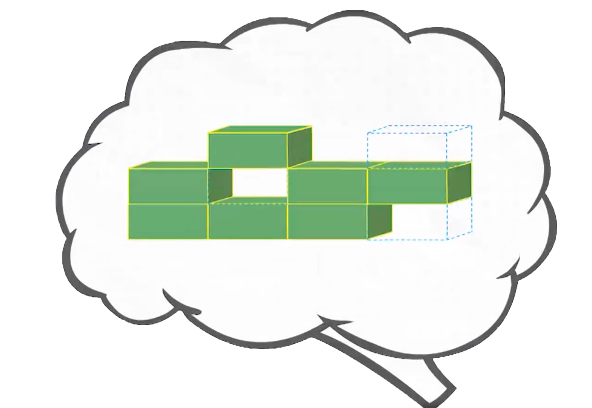
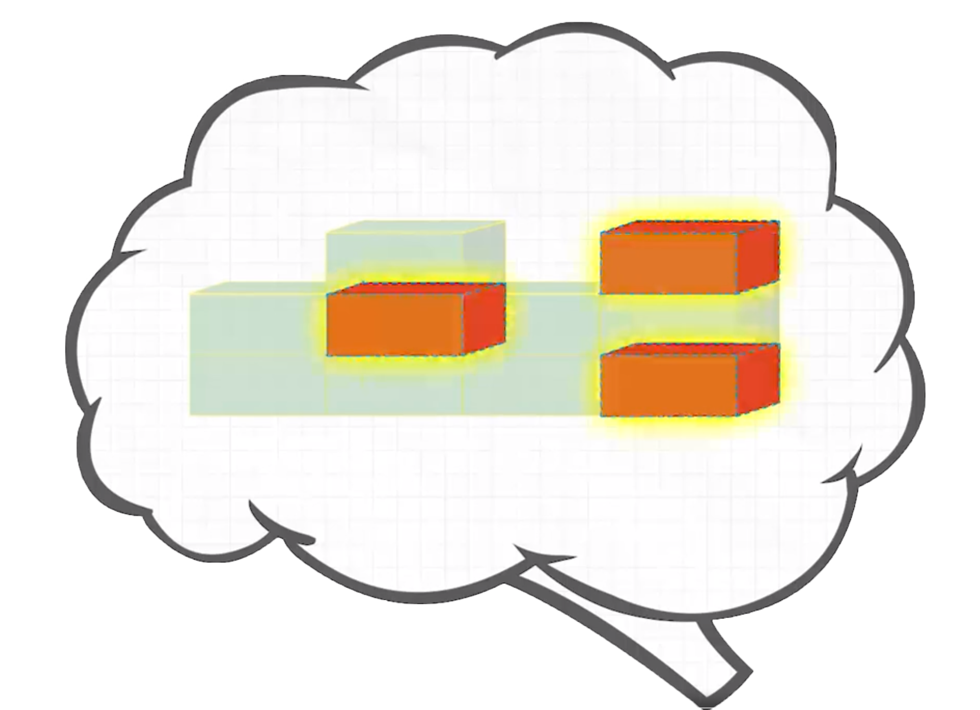
Remember, the Diagnostic is important because it helps you and your teachers . . .
Understand what you already know
and what you need to learn
Notes:
Today, when you complete your Diagnostic, you will see a score pop up on your screen. This score is one of many that you will see on your Diagnostic report. Your Diagnostic report will help us see the areas where you have strengths and the areas where we can help you grow. We will talk about your Diagnostic report and your personal learning goals when we meet for our data chat.

Slide 8
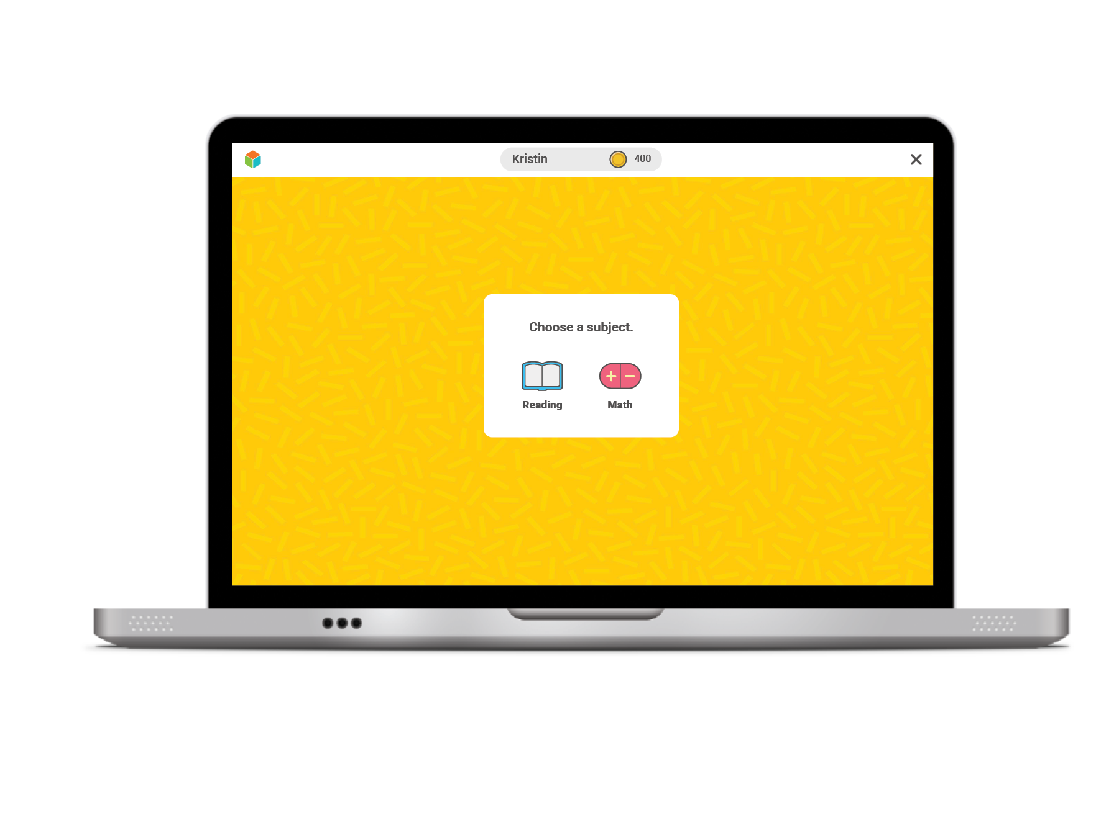
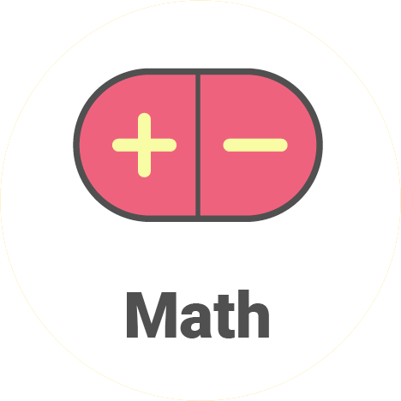
Once you log in, you will see this:
Once you log in, yu will see this:
For Reading, click on the book.
For Math, click on the math signs.
I will tell you which one to click.

Slide 9
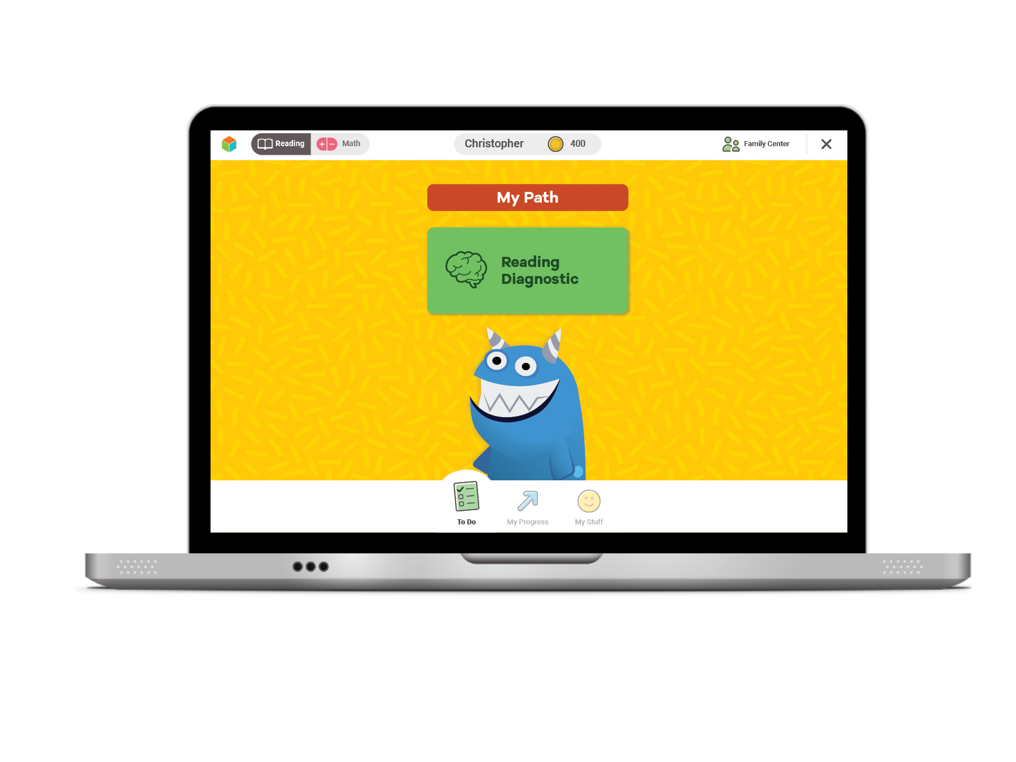
Next, you will see a page like this:
Click the green button to start your Diagnostic.

Slide 10
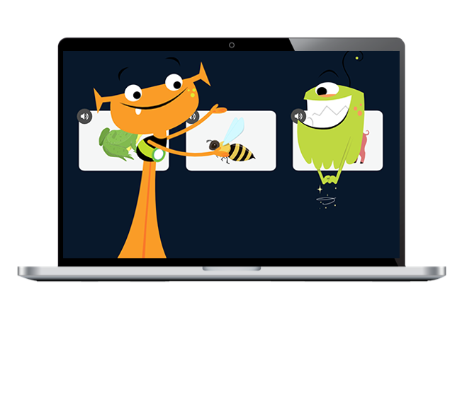
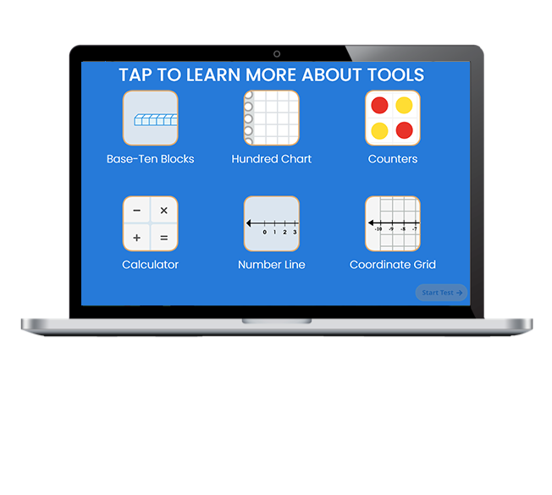
Next, you will:
Watch a video.
Click on each button to watch a video about a tool. Then select START TEST.

Slide 11
Introductory Demo Videos
Optional
You will get to try this on your own!
MATH
READING
Optional

Slide 12
Helpful Tips
Take your time and do not rush.
Read each question and answer
choice carefully.
If you get a question you have not learned yet, try your best!

Slide 13
Helpful Tips
For Math—Show your work.
For Reading—Read each passage carefully.
Check your work.

Slide 14
Our Plan
After the Diagnostic, i-Ready creates a special report for you and your family.

Slide 15
Why are we taking this again?
Taking this Diagnostic helps us:
Celebrate what you learned
Know your progress toward goals
Learn how much you need to know before the end of the year
Get new lessons that are just right for you

Slide 16
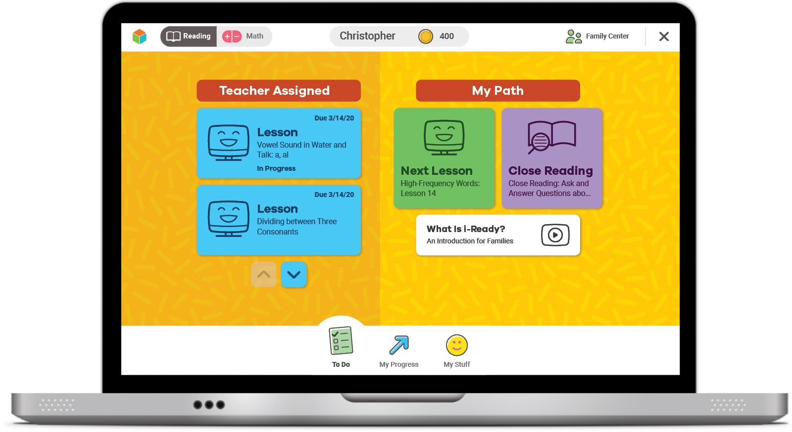
Online Lessons
After your Diagnostic, you'll get new Lessons.
If you try your best on the Diagnostic, online lessons will match what you need to learn.

Slide 17
Talk about How We Take the Diagnostic
As a class, something we did well was . . .
As a class, let's work on . . .

Slide 18
Our Incentives
Optional
Class incentives
Individual incentives
Optional

Slide 19
Let’s Remember
To do my best on i-Ready,
I will . . .

Slide 20
You Will Rock It!

Slide 21
Get Pumped Up for Success!
Grades 1–2

Slide 22
What We Will Cover
Things to Know
What to Expect
Introduction Videos
Tips
Let's Remember

Slide 23
“Why are we taking the i-Ready Diagnostic?”

Slide 24
Remember, the Diagnostic is important because it helps you and your teachers . . .
Show what you know! Try your best so you can show what you've learned.
Make the best use of your learning time
Understand what you already know
and what you need to learn
Notes:
Today, when you complete your Diagnostic, you will see a score pop up on your screen. This score is one of many that you will see on your Diagnostic report. Your Diagnostic report will help us see the areas where you have strengths and the areas where we can help you grow. We will talk about your Diagnostic report and your personal learning goals when we meet for our data chat.

Slide 25
Why are we taking this again?
Taking this Diagnostic helps us:
Celebrate what you learned
Know your progress toward goals
Learn how much you need to know before the end of the year
Get new lessons that are just right for you

Slide 26
Online Lessons
If you try your best on the Diagnostic, lessons will match what you need to learn.
The results of your Diagnostic decide what lessons you will get.

Slide 27
Talk about How We Take the Diagnostic
As a class, something we did well was . . .
As a class, let's work on . . .

Slide 28
What should you do?
Remember this test is adaptive! You should try your best, but know that you'll get questions you don't know how to answer.
You will see questions you won't know how to answer because you haven't learned them yet. That is okay! Choose the best answer and move on.
Try your best. Do not rush, but do not spend too much time on any one question.
Too Hard
Too Easy
Just Right

Slide 29
Once you log in, you will see this:
For Reading, click on the book.
For Math, click on the math signs.
I will tell you which one to click.

Slide 30
Next, you will see a page like this:
Click the green button to start your Diagnostic.

Slide 31
Next, you will:
Watch a video.
Click on each button to watch a video about a tool. Then select START TEST.

Slide 32
Introductory Demo Videos
Optional
You will get to try this on your own!
MATH
READING
Optional

Slide 33
Helpful Tips
Take your time and do not rush.
Read each question and answer choice carefully.
If you get a question you have not learned yet, try your best!

Slide 34
Helpful Tips
For Math—Show your work.
For Reading—Read each passage carefully.
Check your work.

Slide 35
Our Plan
After the Diagnostic, i-Ready creates a special report for you and your family.

Slide 36
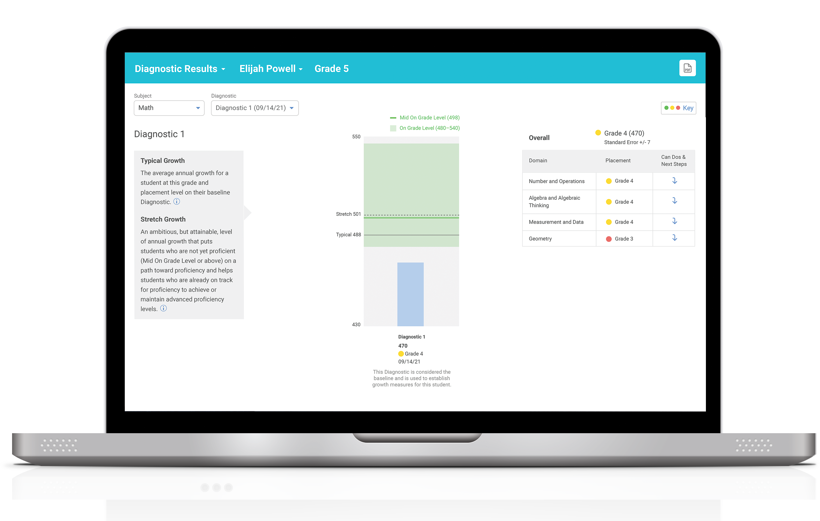
Our Plan
After the Diagnostic, we can review your results and goals.

Slide 37
Our Incentives
Optional
Class incentives
Individual incentives
Optional

Slide 38
Reflection
To do my best on i-Ready, I will . . .

Slide 39
You Will Rock It!

Slide 40
Get Pumped Up for Success!
Grades 3–5

Slide 41
What We Will Cover
Things to Know
What to Expect
Introduction Videos
Tips
Let's Remember

Slide 42
“Why are we taking the i-Ready Diagnostic?”

Slide 43
Remember, the Diagnostic is important because it helps you and your teachers . . .
Understand what you already know
and what you need to learn
Notes:
Today, when you complete your Diagnostic, you will see a score pop up on your screen. This score is one of many that you will see on your Diagnostic report. Your Diagnostic report will help us see the areas where you have strengths and the areas where we can help you grow. We will talk about your Diagnostic report and your personal learning goals when we meet for our data chat.

Slide 44
Remember, the Diagnostic is important because it helps you and your teachers . . .
Make the best use of your learning time
Notes:
Today, when you complete your Diagnostic, you will see a score pop up on your screen. This score is one of many that you will see on your Diagnostic report. Your Diagnostic report will help us see the areas where you have strengths and the areas where we can help you grow. We will talk about your Diagnostic report and your personal learning goals when we meet for our data chat.

Slide 45
Remember, the Diagnostic is important because it helps you and your teachers . . .
Show what you know! Try your best so you can show what you’ve learned.
Notes:
Today, when you complete your Diagnostic, you will see a score pop up on your screen. This score is one of many that you will see on your Diagnostic report. Your Diagnostic report will help us see the areas where you have strengths and the areas where we can help you grow. We will talk about your Diagnostic report and your personal learning goals when we meet for our data chat.

Slide 46
Why are we taking this again?
Taking the next Diagnostic helps us:
Celebrate what you learned
Know your progress toward goals
Learn how much you need to know before the end of the year
Get new lessons that are just right for you

Slide 47
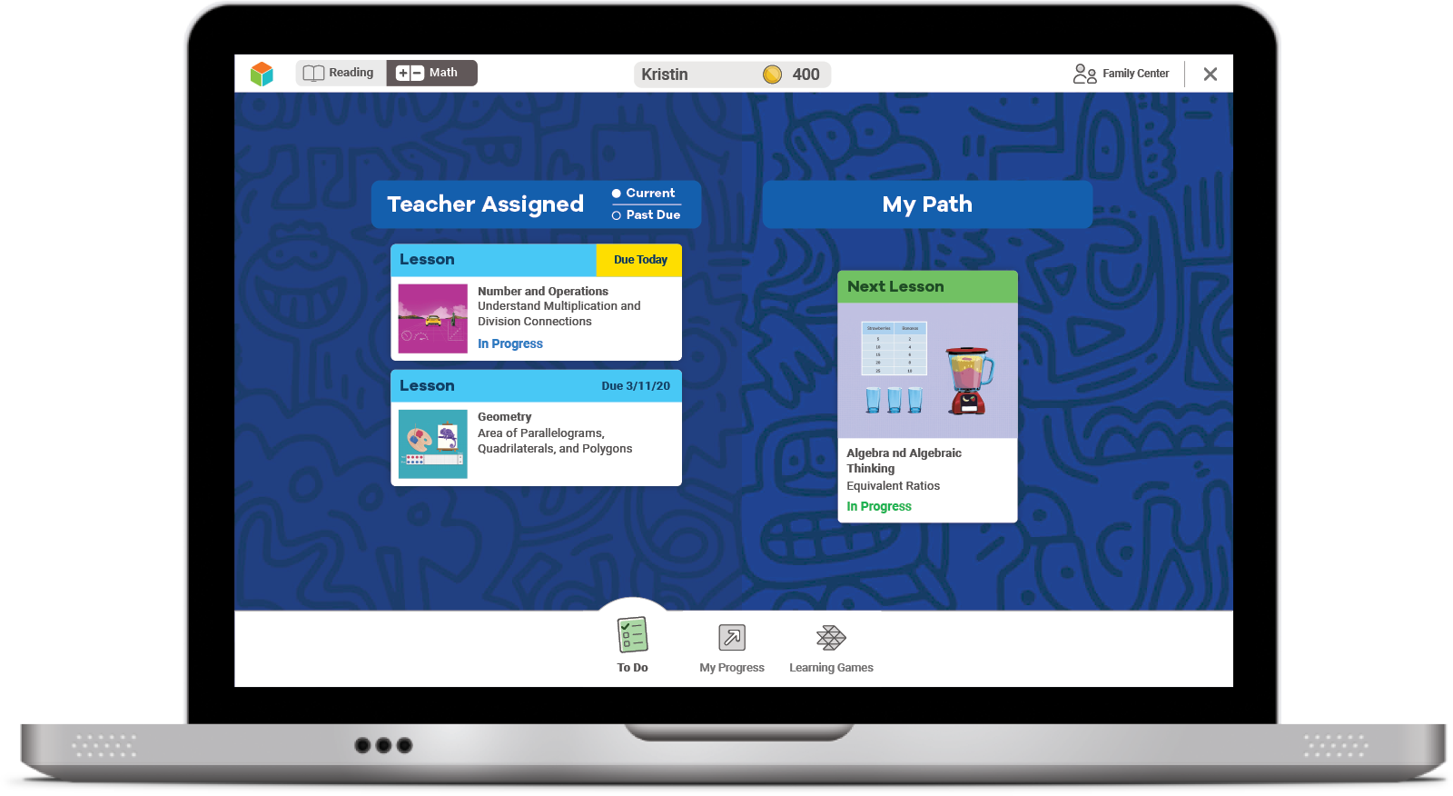
Online Lessons
If you try your best on the Diagnostic, lessons will match what you need to learn.
The results of your Diagnostic decide what lessons you will get.

Slide 48
How does the Diagnostic work?
i-Ready is an adaptive test. This means the questions change based on your answers.
Some questions will be . . .
Hard
Easy
Just Right!

Slide 49
Talk about How We Take the Diagnostic
As a class, something we did well was . . .
As a class, let's work on . . .

Slide 50
What should you do?
Remember this test is adaptive! You should try your best, but know that you’ll get questions you don’t know how to answer.

Slide 51
What should you do?
Try your best. Do not rush, but do not spend too much time on any one question.

Slide 52
What should you do?
You will see questions you won’t know how to answer because you haven’t learned them yet. That is okay! Choose the best answer and move on.
Too Hard
Too Easy
Just Right

Slide 53
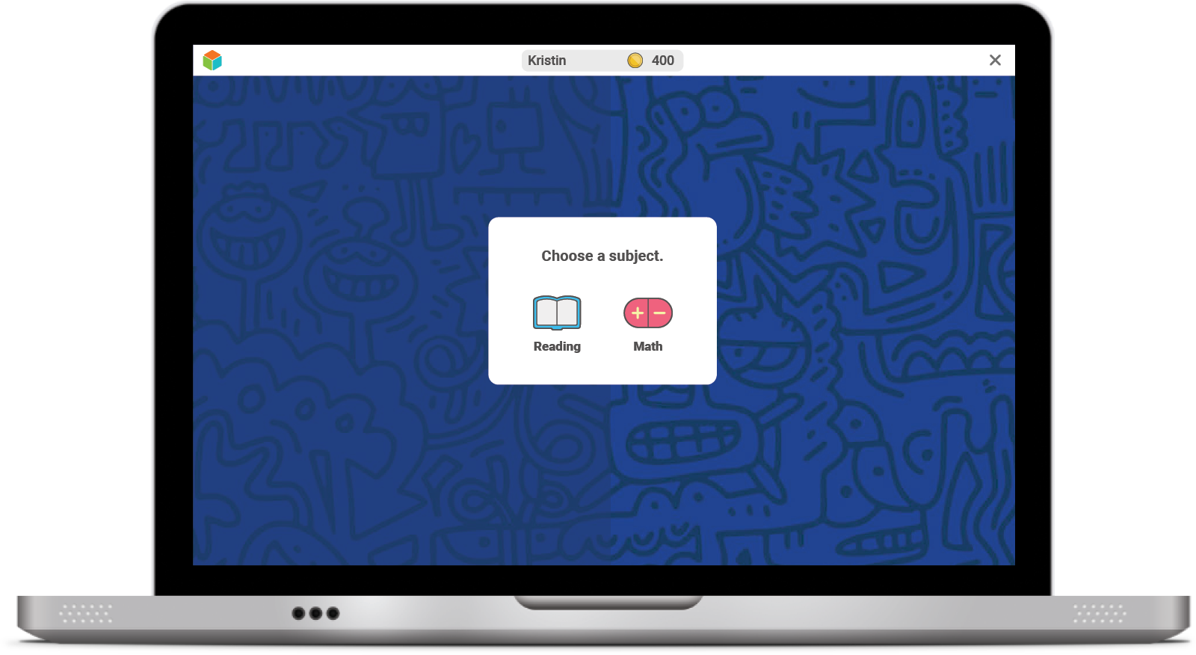
Once you log in, you will see this:

Slide 54
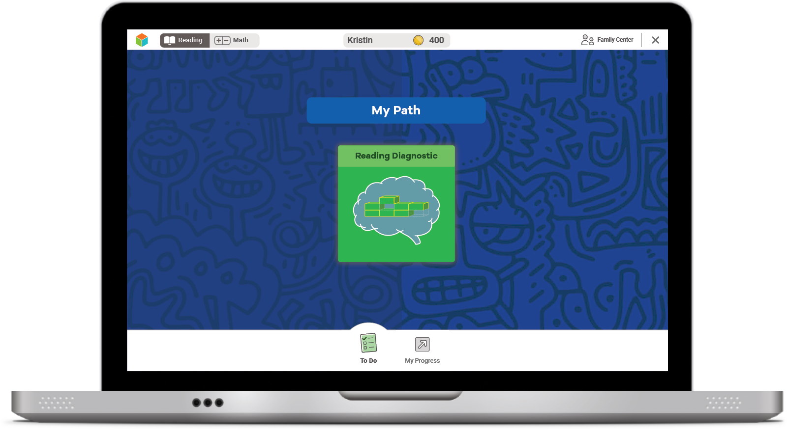
Next, you will see a page like this:
Select the green button to start your Diagnostic.

Slide 55
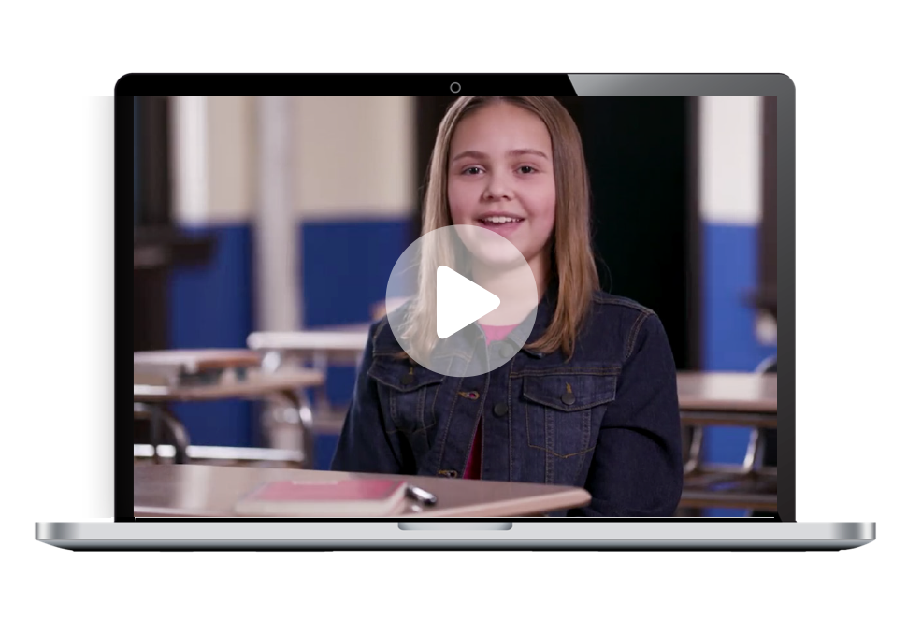
Next, you will:
Watch a video.

Slide 56
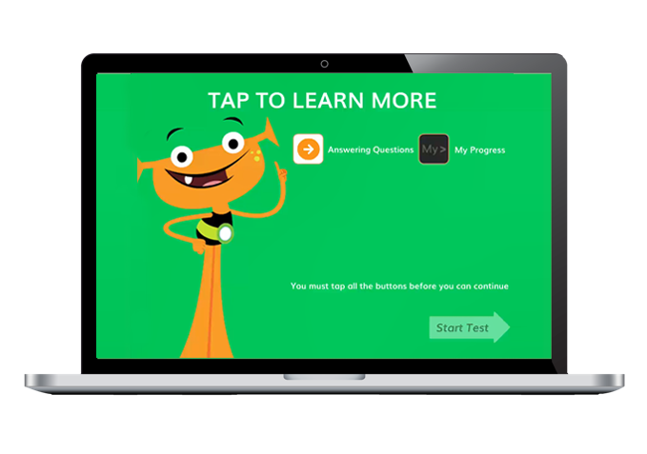
Next, you will:
Watch a video.
Click on each button to watch a video about each tool.

Slide 57
Next, you will:
Watch a video.
You must click on all of them before you can press start.

Slide 58
Introductory Demo Videos
Optional
You will get to try this on your own!
MATH
READING

Slide 59
Helpful Tips
Take your time and do not rush.
Read each question and answer choice carefully.
If you get a question you have not learned yet, try your best.
For Math—Show your work on paper for every problem.
For Reading—Read each passage carefully, and reread the passage when necessary.
Check your work before going to the next question.

Slide 60
Our Plan
After the Diagnostic, i-Ready creates a special report for you and your family.

Slide 61
Our Plan
We can talk about:
How you did
Your growth goals
Your strengths and areas for growth
After the Diagnostic, we can review your results and goals.

Slide 62
Our Incentives
Optional
Class incentives
Individual incentives
Optional
Optional
Notes:
For ideas from other educators, visit i-ReadyCentral.com/Ideas.

Slide 63
Reflections
What strategies do you plan to use on your i-Ready Diagnostic?
What do you want to remember?

Slide 64
Get Pumped Up for Success!
Grades 6–8

Slide 65
What We Will Cover
Things to Know
Tips
What to Expect
Let's Remember
Introduction Videos

Slide 66
“Why are we taking the i-Ready Diagnostic?”

Slide 67
Remember, the Diagnostic is important because it helps you and your teachers . . .
Understand what you already know
and what you need to learn
Notes:
Today, when you complete your Diagnostic, you will see a score pop up on your screen. This score is one of many that you will see on your Diagnostic report. Your Diagnostic report will help us see the areas where you have strengths and the areas where we can help you grow. We will talk about your Diagnostic report and your personal learning goals when we meet for our data chat.

Slide 68
Why are we taking this again?
Taking the next Diagnostic helps us:
Celebrate what you learned
Know your progress toward goals
Learn how much you need to know before the end of the year
Get new lessons that are just right for you

Slide 69
Online Lessons
If you try your best on the Diagnostic, lessons will match what you need to learn.
The results of your Diagnostic decide what lessons you will get.

Slide 70
Talk about How We Take the Diagnostic
As a class, something we did well was . . .
As a class, let's work on . . .

Slide 71
How does the Diagnostic work?
i-Ready is an adaptive test. This means the questions change based on your answers.
Some questions will be . . .
HARD
EASY
JUST RIGHT

Slide 72
What should you do?
Remember this test is adaptive! You should try your best, but know that you'll get questions you don't know how to answer.

Slide 73
What should you do?
Try your best. Do not rush, but do not spend too much time on any one question.

Slide 74
What should you do?
You will see questions you won’t know how to answer because you haven’t learned them yet. That is okay! Choose the best answer and move on.
Too Hard
Too Easy
Just Right

Slide 75
Once you log in, you will see this:

Slide 76
Next, you will see a page like this:
Select the green button to start your Diagnostic.

Slide 77
Next, you will:
Watch a video.

Slide 78
Next, you will:
Watch a video.
Click on each button to watch a video about each tool.

Slide 79
Next, you will:
Watch a video.
You must click on all of them before you can press start.

Slide 80
Introductory Demo Videos
Optional
MATH
READING

Slide 81
Helpful Tips
Take your time and do not rush.
Read each question and answer choice carefully.
If you get a question you have not learned yet, try your best.
For Math—Show your work on paper for every problem.
For Reading—Read each passage carefully, and reread the passage when necessary.
Check your work before going to the next question.

Slide 82
Our Plan
After the Diagnostic, i-Ready creates a special report for you and your family.

Slide 83
Our Plan
We can talk about:
Progress toward your growth goals
Your strengths and areas for growth
How you did
After the Diagnostic, we can review your results and goals.

Slide 84
Our Incentives
Optional
Class incentives
Individual incentives
Notes:
For ideas from other educators, visit i-ReadyCentral.com/Ideas.

Slide 85
Reflections
Why is it important to try your best on the Diagnostic?
What strategies do you plan to use on your i-Ready Diagnostic?
What do you want to remember?

Slide 86
Embedded Universal Supports
Grades K–8

Slide 87
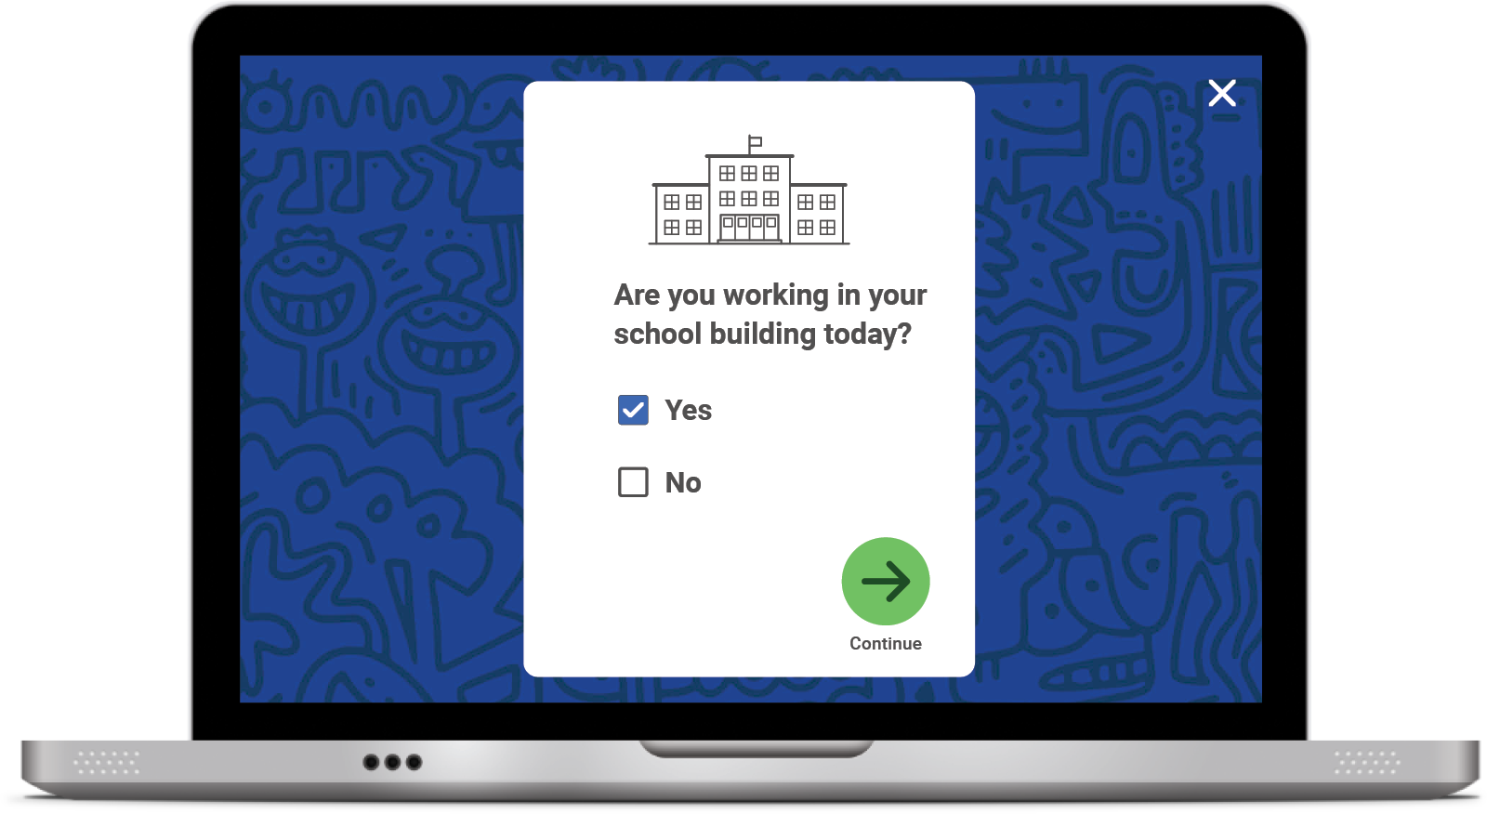
Keyboard Navigation
How: Using specific keyboard selections:
Tab, Shift + Tab, and Enter or Space
A box will appear showing where you are on the screen.
The Tab key will initiate keyboard navigation features.

Slide 88
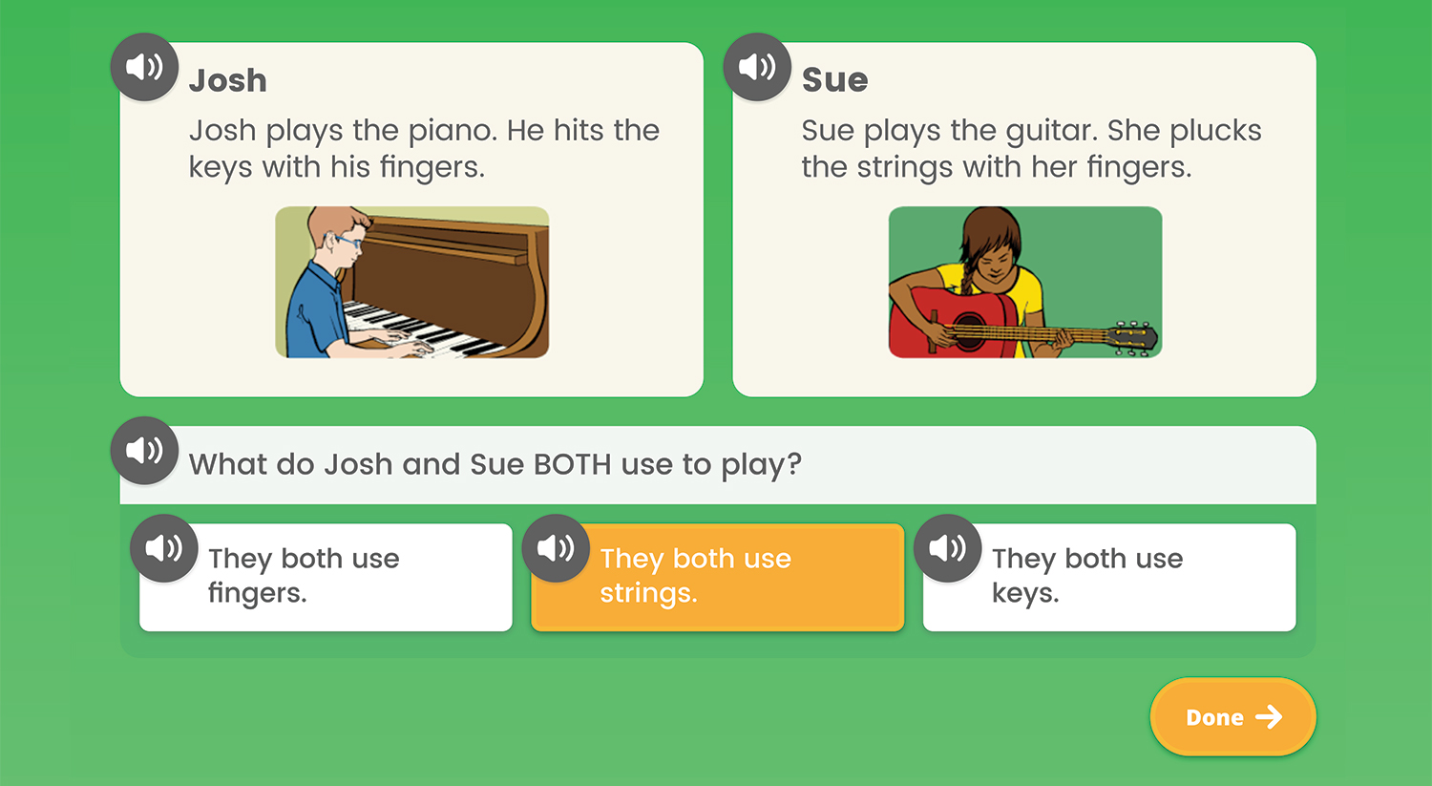
Audio Support
How: Using the speaker icon, wherever it appears
Notes:
Audio support is currently available for Diagnostic items at these levels:
Mathematics: Grades K–5
Phonics: Grades K–3
High-Frequency Words: Grades K–3
Vocabulary: Grades K–2
Phonological Awareness: Grades K–1
Reading Comprehension: Grade K
What: Provides the ability to click on an audio button (speaker icon) to have the corresponding text for a question and/or answer read aloud
Where: For select items in the Diagnostic, based on the domain and/or level of the items

Slide 89
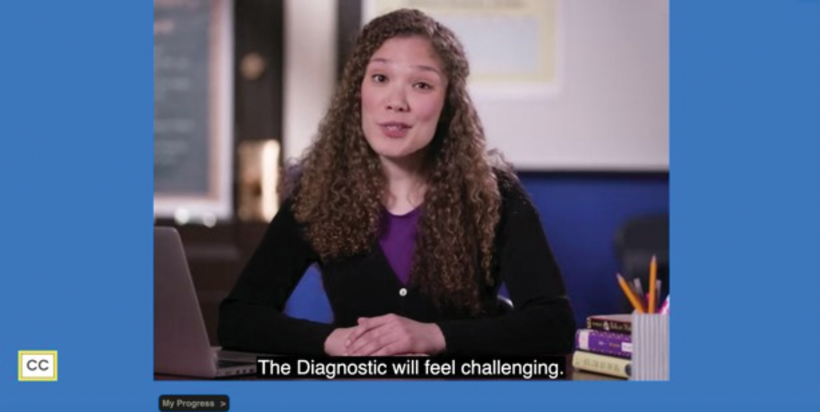
Closed Captioning
How: Using the CC box in the bottom left corner of the screen
Clicking the CC box allows you to view the text on the screen.
Notes:
What: Provides the ability to display text on the computer screen that aligns to the audio
Where: In Diagnostic Introductory Videos for Grades 3+ when viewed through the student-facing Diagnostic assessment screen. Closed captioning is not available for test items at this time.

